Slide 1
11
Supply Chain Management

Slide 2
Supply Chain Management
Supply Chain: the sequence of organizations - their facilities, functions, and activities - that are involved in producing and delivering a product or service.
Sometimes referred to as value chains

Slide 3
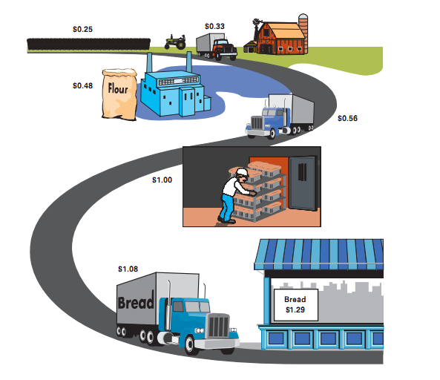
A Supply Chain for Bread

Slide 4
Typical Supply Chain for a Manufacturer
Figure 11.1a
Supplier
}
Supplier
Storage
Mfg.
Storage
Dist.
Retailer
Customer
Supplier

Slide 5
Benefits of Supply Chain Management
Lower inventories
Higher productivity
Greater agility
Shorter lead times
Higher profits
Greater customer loyalty
Integrates separate organizations into a cohesive operating system

Slide 6
A Framework for Structuring Drivers
Competitive Strategy
Supply Chain
Strategy
Efficiency
Responsiveness
Supply chain structure
Facilities
Inventory
Transportation
Information
Sourcing
Pricing

Slide 7
Drivers of Supply Chain Performance
Facilities
places where inventory is stored, assembled, or fabricated
production sites and storage sites
Inventory
raw materials, WIP, finished goods within a supply chain
inventory policies
Transportation
moving inventory from point to point in a supply chain
combinations of transportation modes and routes
Information
data and analysis regarding inventory, transportation, facilities throughout the supply chain
potentially the biggest driver of supply chain performance
Sourcing
functions a firm performs and functions that are outsourced
Pricing
Price associated with goods and services provided by a firm to the supply chain

